Slide 1

Test of Oracle JSON support in the view of CMS JSON data
Sartaj Singh Baveja
Supervisors : Katarzyna Maria Dziedziniewicz-Wojcik (CERN IT)
Valentin Kuznetsov (CMS)

Slide 2




Who am I?
Alumnus of NSIT
Will join Lawrence Berkeley Labs as a Research scholar
Previously interned at MIT Media Lab, ESnet

Slide 3
Contents
Importance of JSON
CMS JSON Data
Current Solution | MongoDB
JSON in Oracle Database
Oracle Release 12.1 vs 12.2
Observations
Comparison
Conclusion
Future Work

Slide 4
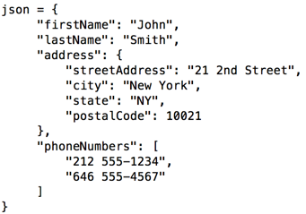
Importance of JSON
Lightweight data-interchange format
Used in web services responses
Easy to parse which makes it easier to use
Notes:
JSON is Javascript Object Notation
Used with AJAX

Slide 5
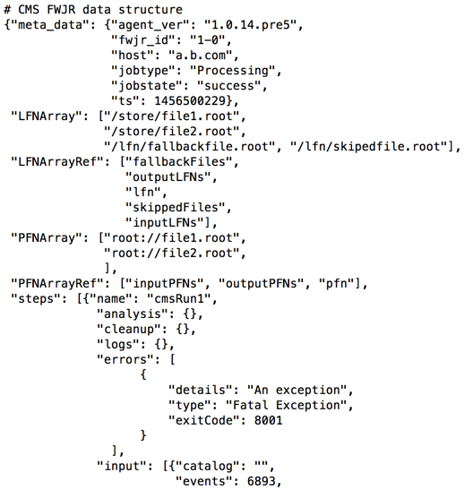
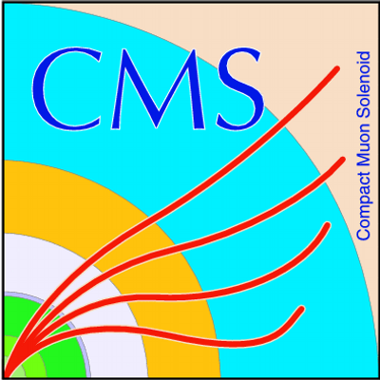
CMS JSON data
200k-300k documents are generated everyday
Size of each document : ~12kB i.e. 3GB/day or 1-2TB/year
Each document
JSON data format
Deep Nested Structure
Represents CMS Framework Job Report

Slide 6

Current Solution | MongoDB
Used by CMS as a buffer before putting docs to HDFS.
Open-source NoSQL database
Provides high performance, high availability, and automatic scaling
Schema Less
Dynamic Queries
Support for full indexes, including inner objects
Notes:
Currently buffer servers only couple of days of data taking O(1M) docs
A record in MongoDB is a document, which is a data structure composed of field and value pairs.
Features : High Performance -> indexes support faster queries
Rich Query Language -> CRUD ops, Aggregation
High Availability -> data redundancy, replication
Automatic Scaling -> horizontally via sharding
avoids the traditional table-based relational database structure in favor of JSON-like documents with dynamic schemas

Slide 7
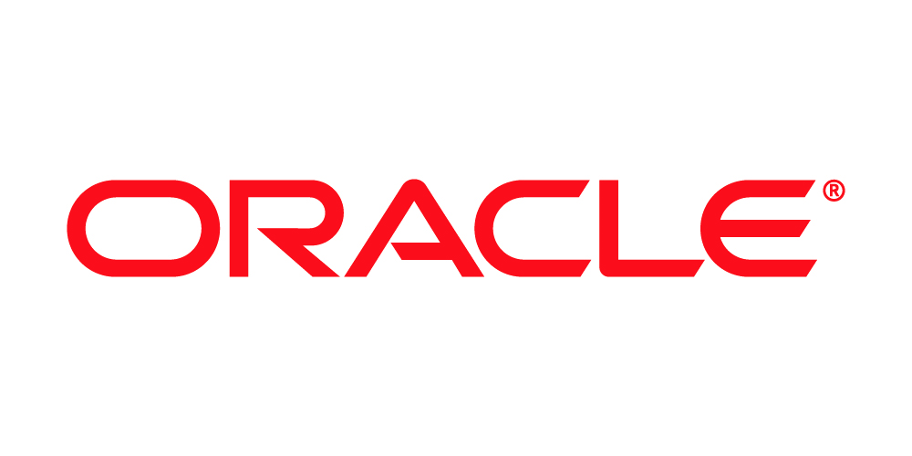
JSON in Oracle Database
Recently introduced JSON support with relational database features such as
Transactions
Indexing
Declarative Querying (join JSON data with relational data, project data relationally)
Views
Ensures data integrity
is_json check constraints to ensure valid JSON instances
Notes:
Data integrity is the maintenance of, and the assurance of the accuracy and consistency of, data over its entire life-cycle

Slide 8
JSON in Oracle Database (contd.)
Stored using SQL Data Types VARCHAR2, CLOB (Character Large Object) and BLOB (Binary Large Object)
Dot notation to access fields of the embedded document

Slide 9
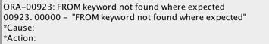
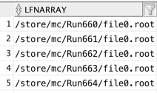
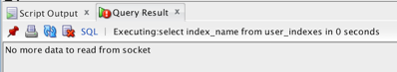
Oracle Release 12.1 vs 12.2
Simplified dot notation doesn’t work on arrays in 12.1 (fixed in 12.2)
ORA 600 : No data to be read from socket appears in 12.1
“Missing right parenthesis” error occurred. Queries such as “SELECT * FROM table” were not working. Due to this, the entire table had to be dropped

Slide 10
OBSERVATIONS
Machine Configuration :
OS MacOSX
Processor 2.6GHz, Intel Core i5
Dual Core
Memory 8GB RAM
Storage 256GB

Slide 11
Generating randomized JSON Documents

Slide 12
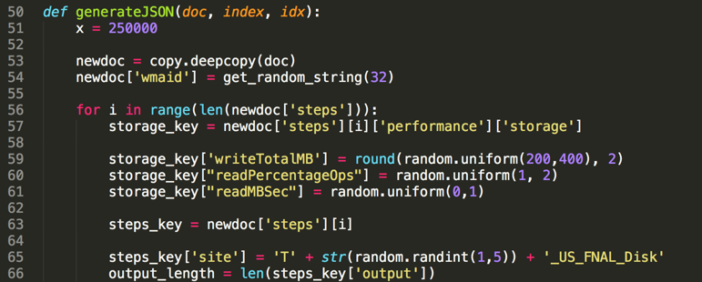
Certain fields randomized according to the CMS Framework Job Report format
Focus on functional tests
Notes:
Wanted a simpler JSON to start with and do the functional tests of Oracle. We wanted to make sure it works as expected with the simple JSON and CMS'es is quite complex and not always compliant to the standard. We didn't know how enforcing Oracle is in terms of standard.

Slide 13
Row Inserts vs Bulk Inserts

Slide 14
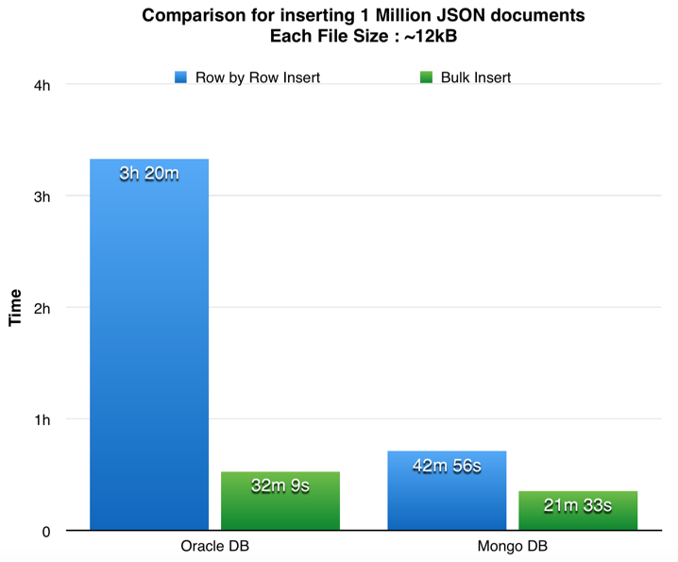
Injection Rate

Slide 15
Indexed vs Non Indexed Queries

Slide 16
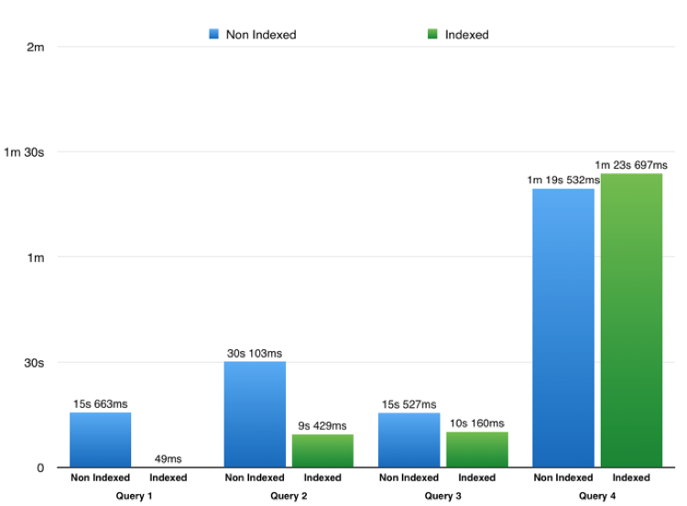
Query 1,2,3 : Find specific string from document
Query 4 : Aggregate data
MongoDB
Indexed vs Non Indexed Queries

Slide 17
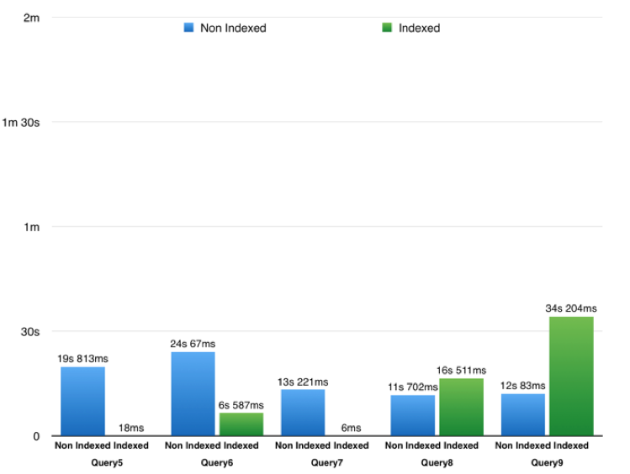
Query 5: Find a string
Query 6/7: Find records based on provided pattern
Query 8,9: Logical / Comparison Query Operators
MongoDB
Indexed vs Non Indexed Queries

Slide 18
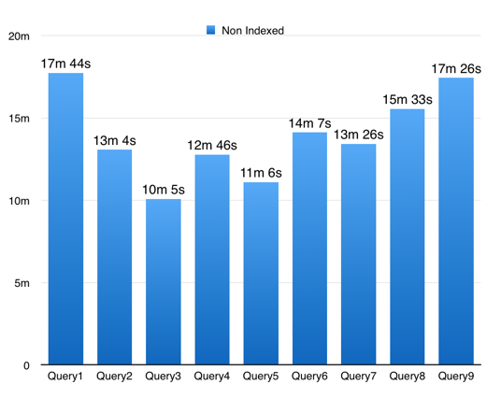
Oracle
Non Indexed Queries
Query 1/2/3: Search for specific string
Query 4: Aggregate data
Query 5: Find a string
Query 6/7: Find records based on pattern
Query 8,9: Logical / Comparison Operators

Slide 19
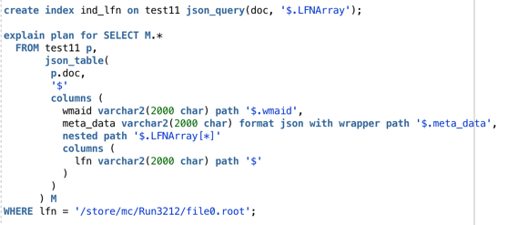
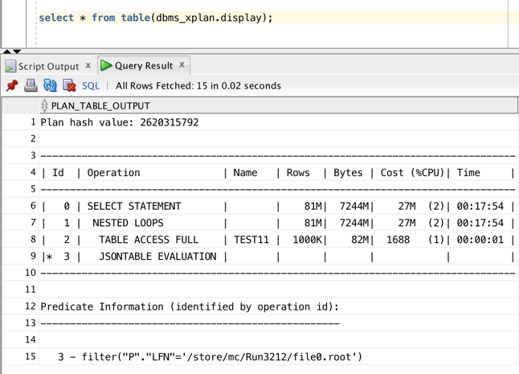
Oracle
Indexed Queries

Slide 20
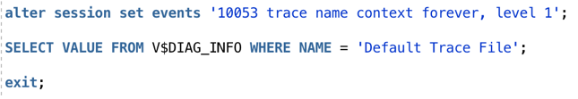
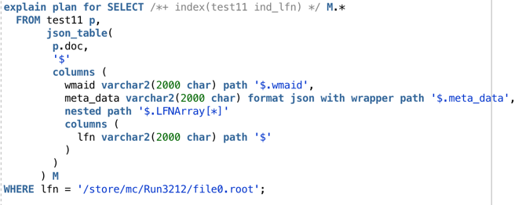
Oracle
Indexed Queries

Slide 21
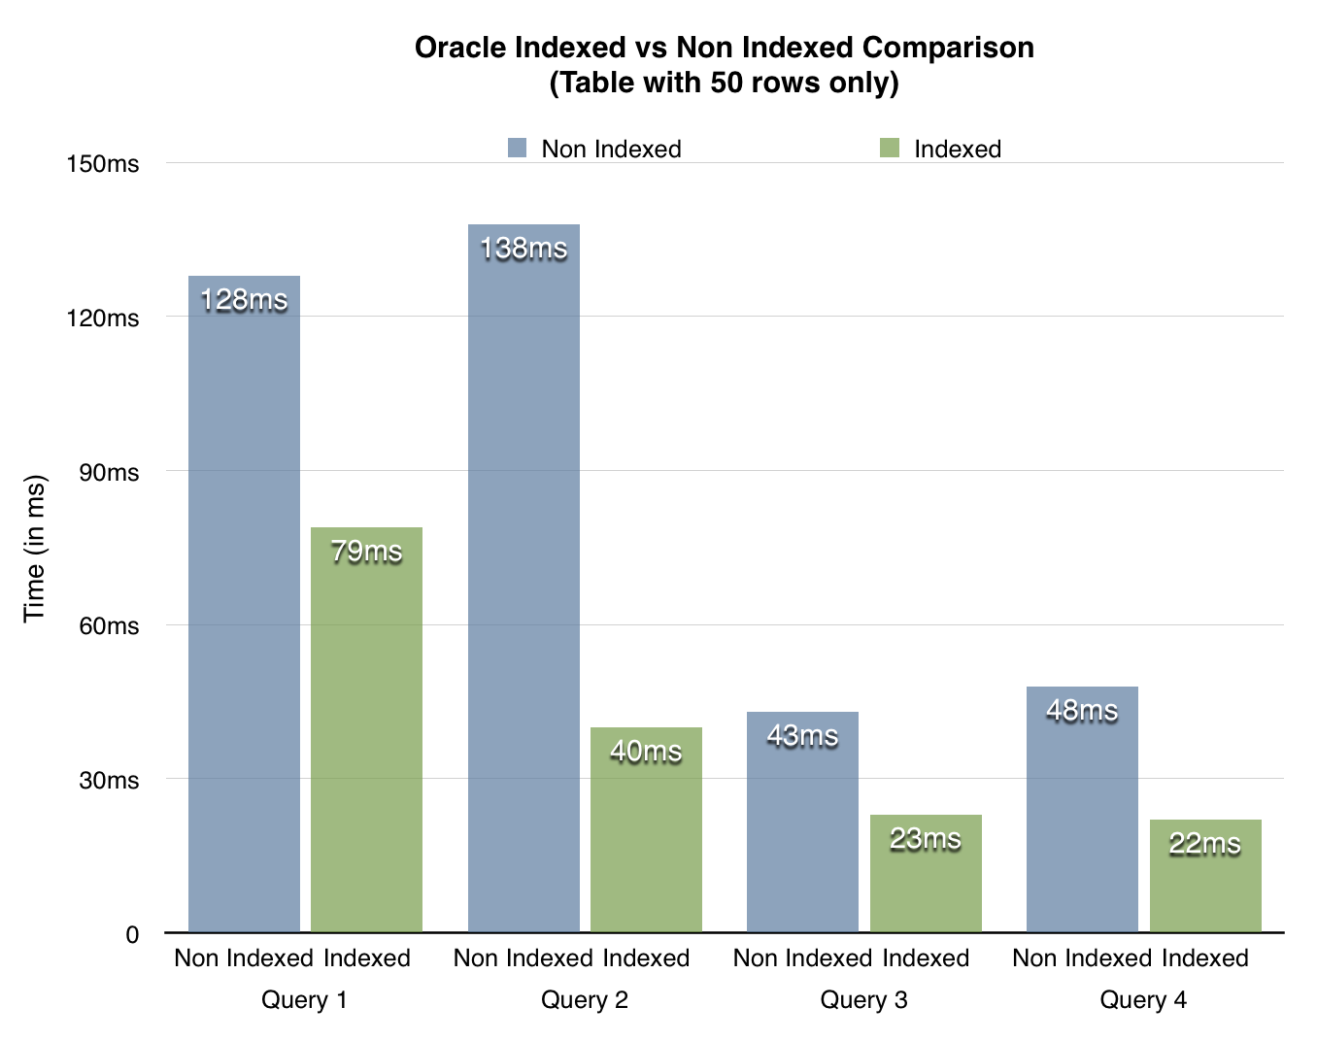
Query 1,2,3 : Find specific string from document
Query 4 : Aggregate data
Oracle
Indexed vs Non Indexed Queries (Smaller Table)

Slide 22
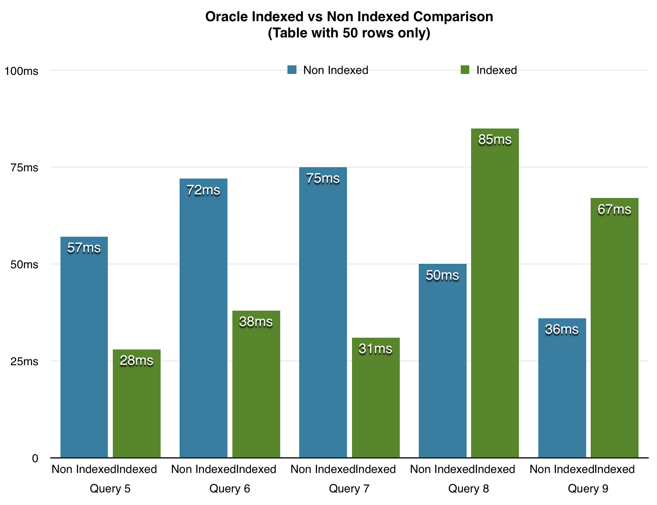
Query 5: Find a string
Query 6/7: Find records based on provided pattern
Query 8,9: Logical / Comparison Query Operators
Oracle
Indexed vs Non Indexed Queries
(Smaller Table)

Slide 23
Oracle : Performance Improvements

Slide 24
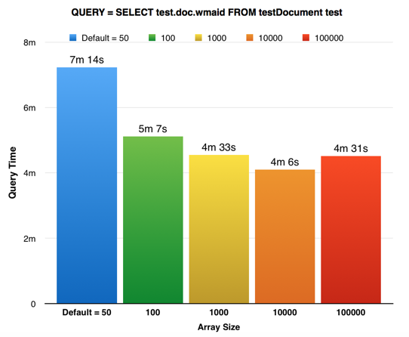
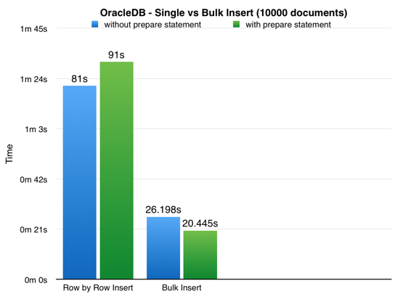
Performance Improvements in OracleDB
Cursor.arraysize
2. Bind Variables
Notes:
The arraysize is set to 100. This causes batches of 100 records at a time to be returned from the database to a cache in Python. This reduces the number of "roundtrips" made to the database, often reducing network load and reducing the number of context switches on the database server. The fetchone(), fetchmany() and even fetchall() methods will read from the cache before requesting more data from the database.
Bind variables enable you to re-execute statements with new values, without the overhead of reparsing the statement. Bind variables improve code reusability, and can reduce the risk of SQL Injection attacks.

Slide 25
Index Size

Slide 26
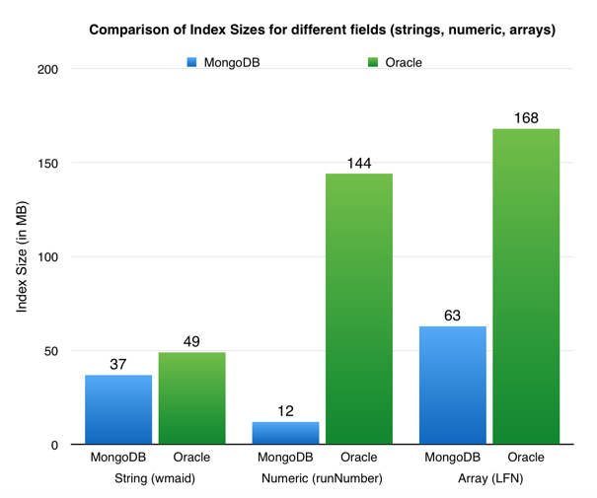
Comparison of Index Sizes

Slide 27
CPU Usage Metrics

Slide 28
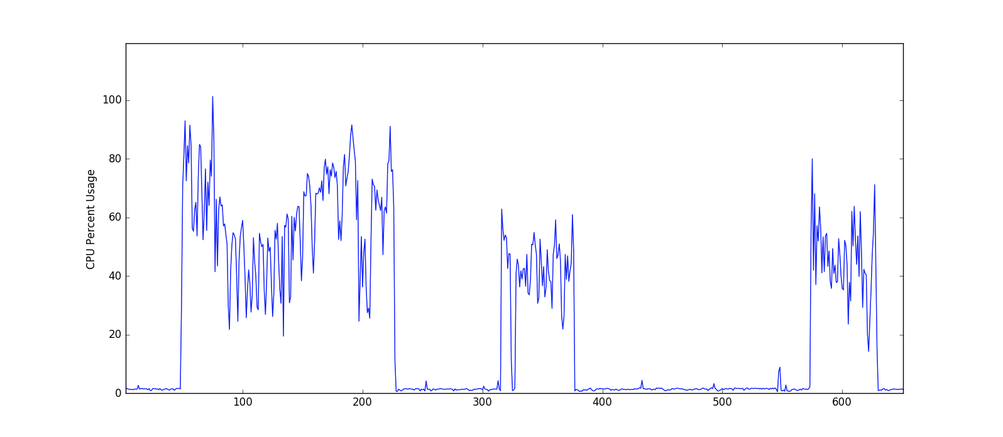
MongoDB CPU Usage

Slide 29
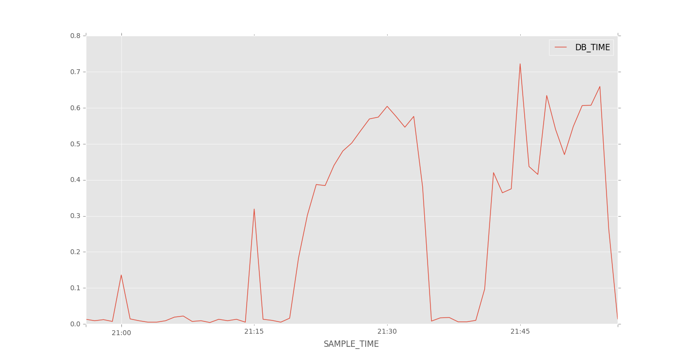
Oracle CPU Usage

Slide 30
COMPARISON

Slide 31
MongoDB | Oracle
Higher Data Size 1.3 GB for 1M documents | Lower Data Size ~50 MB for 1M documents
223 MB Index Size | 1.14 GB Index Size
Queries are not atomic | Queries are atomic
Lower Insert Time | Higher Insert Time
Indexing works perfectly | Indexing not straightforward
No such errors | Internal errors such as “No Data to be read from socket” occur frequently
Notes:
1. Long Field Names: A collection in Mongo with N documents stores the field names N times. If the field names are too long you are wasting space.
2. Power of 2 allocation strategy (only for MMAP engine): Is now the default record allocation strategy for MMAPv1. With the power of 2 sizes allocation strategy, each record has a size in bytes that is a power of 2 (e.g. 32, 64, 128, 256, 512 ... 2MB). If your document size is 33 then mongo will allocate 64 and you are wasting half your storage.
This is to avoid issues with disk fragmentation by pre-allocating space in large files.
3. Compression (only for MMAP engine): Oracle is using compression while MMAP engine not
Atomic means that it can miss documents which are being updated while the query is running and which do match the query both before and after an update
http://stackoverflow.com/questions/15750301/how-to-guarantee-atomic-sql-inserts-with-subqueries

Slide 32
Conclusion
Both the databases support JSON completely
Both databases were successful in executing all the given queries
Oracle’s JSON library looks promising
Has a few errors which will improve as further versions are released
Can perform read/writes and queries

Slide 33


Future Work
Compare the performance with other databases
Postgres
MySQL
Indexing with Oracle JSON Library

Slide 34




Thank You!
sartajcorp@gmail.com
www.sartajsingh.in
sartaj10

